Slide 1
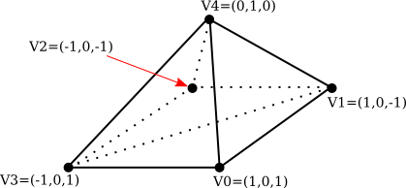
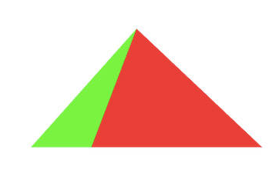
CSE4204 Assignment - 3
Draw a pyramid with 5 vertices using the index buffer. Scale it by s = 0.75. Rotate the scaled pyramid by r = 30 degrees. Pass both scaling factor (s) and rotation degree (r) to shader from JavaScript.

